Slide 1
Software Testing and Quality Assurance
Baolei Cheng(程宝雷)
chengbaolei@suda.edu.cn

Slide 2
Something about this course
Academic degree course
English&Chinese teaching & learning
Some rules: attendance/homework/exercises
The references

Slide 4
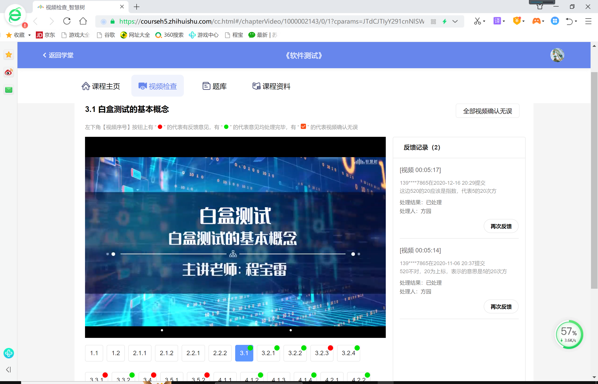

Slide 5
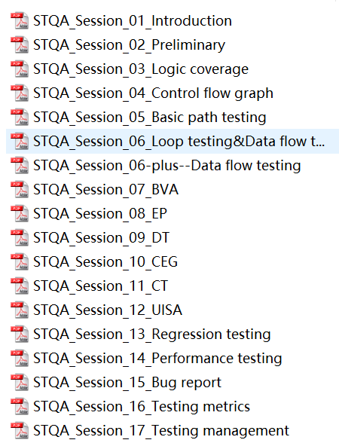
The contents
Introduction of STQA
Basic concepts of STQA
Testing methods: White-box & Black-box
Testing phases: U-I-S-A Testing
Testing report
Testing metrics

Slide 6
Score？
Course objectives？
Application in graduation project
Publication of papers

Slide 7
Session 1 Introduction of Software Quality Assurance and Software Testing

Slide 8
Objectives
In this session, you will learn:
The basic idea of SQA
Quality assurance and quality control
Testing overview

Slide 9
Why we need software testing?

Slide 10
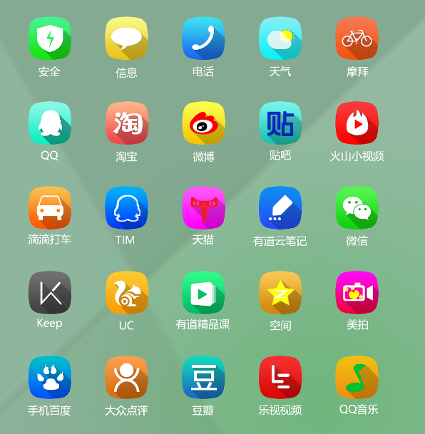
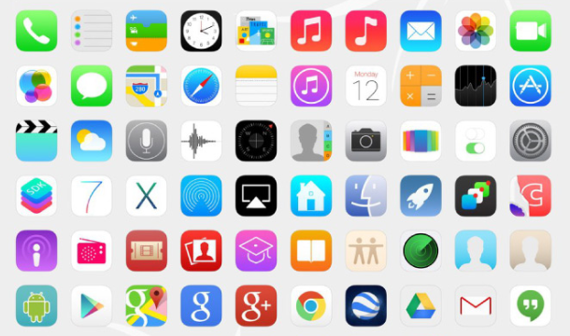
We need software

Slide 11
软件的组成部分有哪些?（ ） A. 计算机程序 B. 计算机程序和文档 C. 计算机程序和规程 D. 计算机程序、规程以及可能的相关文档和运行计算机系统所需的数据

Slide 12
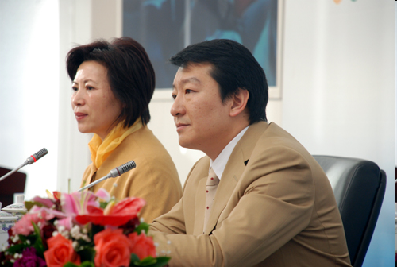
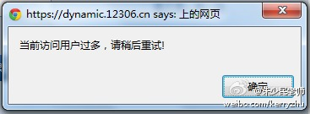
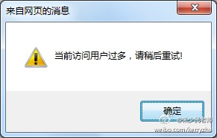
We need software of good quality
08奥运票务中心、12306的道歉
2007年10月30日，北京奥运会第二阶段门票销售刚启动就因为购票者太多而被迫暂停。低估了群众购票的热情，导致售票系统出现了瓶颈问题

Slide 13
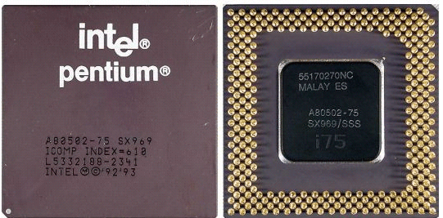
一个缺陷造成了数亿美元损失
（4195835／3145727）×3145727- 4195835 = ?
最后 Intel公司付出很大代价，回收CPU，造成4亿美元损失

Slide 14
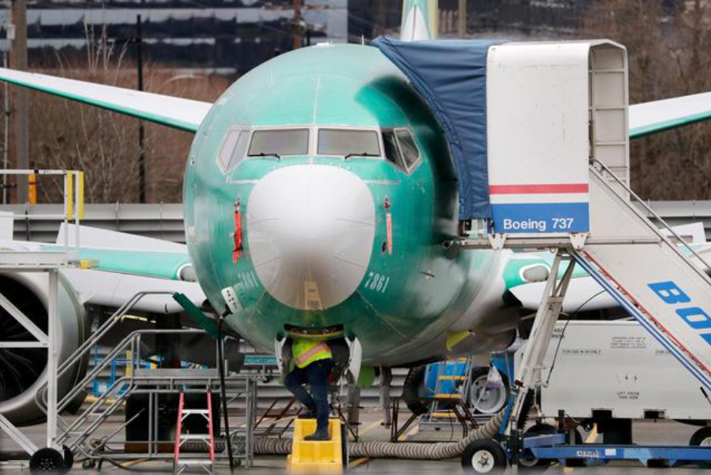
波音737 MAX 软件故障

Slide 15
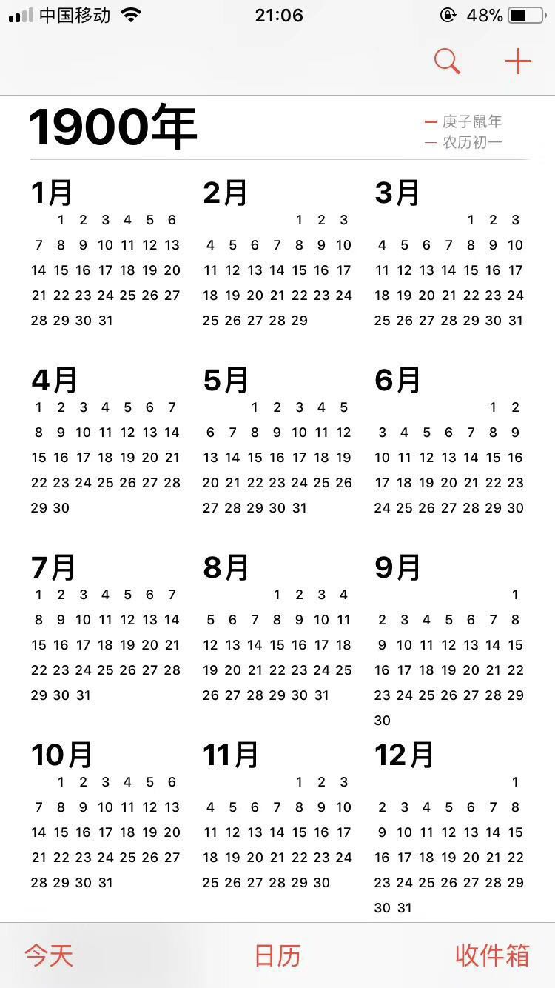
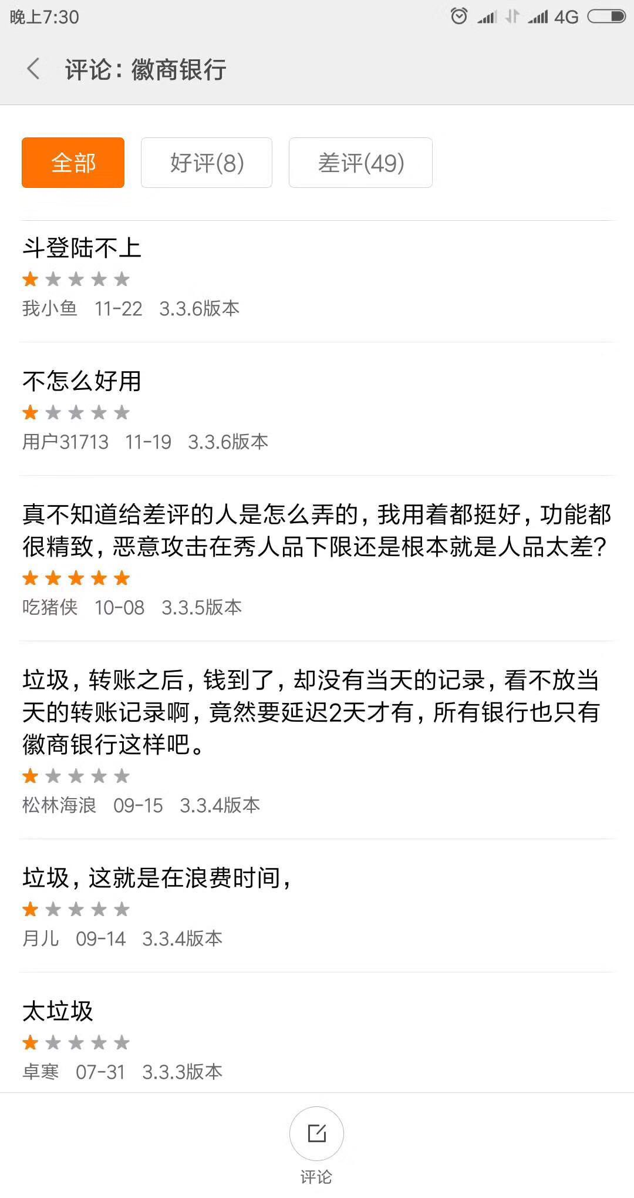

Slide 16
We need some methods to ensure the quality

Slide 17
为什么要进行软件测试?
软件错误
在软件生命周期内不希望或不可接受的人为错误，结果导致软件缺陷的产生
软件缺陷
缺陷存在于软件及相关的文档中，在特定的条件下会使软件产生故障
软件故障
软件处于一种不希望或不可接受的内部状态，不及时处理就会使软件失效
软件失效
软件处于一种不希望或不可接受的外部状态
软件总存在缺陷。只有通过测试，才可以发现软件缺陷。也只有发现了缺陷，才可以将软件缺陷从软件产品或软件系统中清理出去
软件中存在的缺陷给我们带来的损失是巨大的，这也说明了软件测试的必要性和重要性
测试是所有工程学科的基本组成单元，自然也是软件开发的重要组成部分
测试人员水平越高，找到软件问题的时间就越早，软件就越容易更正，产品发布之后越稳定，收益越大

Slide 18

Dog and Testing

Slide 19

Eating your own dog food，Dogfooding
自己公司使用自己开发的产品
1988 年，微软的高管 Paul Maritz 在写给测试主管的一封邮件中
Kal Kan 宠物食物公司的总经理，每年的股东大会上，都吃一罐自己公司的狗粮。
二战期间降落伞
百度无人车

Slide 20
Fundamentals of Software Quality Assurance
Quality is defined as the degree of excellence of a software.
Quality can be interpreted as meeting the following customer requirements:
Explicit
External: features, usability
Implicit
Internal: maintainability, user experience

Slide 21
Introducing Software Quality Assurance
To ensure quality in the software development process, you need to implement software quality assurance activities in each phase of the Software Development Life Cycle (SDLC).
SQA is a planned and systematic approach for monitoring and improving the software development process.
SQA processes evaluate the adherence of a software product to software product standards.

Slide 22
Introducing Software Quality Assurance (Contd.)
SQA Activities in Various Phases of the SDLC:
Software conception and initiation
Analysis
Design
Construction
Testing

Slide 23
Introducing Software Quality Assurance (Contd.)
To ensure that the quality assurance objectives are met, a project SQA plan is created.
A part of comprehensive project plan
Specifies the QA procedure
Assigns roles and responsibilities
Plan-Do-Check-Action

Slide 24
Quality Assurance and Quality Control
Quality activities can be segmented into two categories:
Preventive activities
Detective activities

Slide 25
Quality Assurance and Quality Control
QA is oriented to the prevention of defects rather than their detection and is used to implement the defined quality policy of an organization through the process of development and continuous improvement.

Slide 26
Quality Assurance and Quality Control (Contd.)
Quality Assurance (QA) activities include:
Quality Audit
Process definition
Tool selection
Training
Peer review
Requirements tracking
Quality metrics collection
…

Slide 27
Quality Assurance and Quality Control (Contd.)
Quality Control (QC) is the process by which the quality of a product is compared with specific standards, and action is taken if the quality does not match the applicable standards.
QC is oriented to detection of defects rather than prevention.

Slide 28
Quality Assurance and Quality Control (Contd.)
QC activities include:
Inspection
Testing
Checkpoint review
…
QA VS. QC

Slide 29
Testing Overview
What is testing ?
Who does testing ?
When to Start testing ?
When to Stop testing ?
5W+1H

Slide 30
Testing Overview
What is testing ?
According to ANSI/IEEE 1059 standard, Testing can be defined as
A process of analyzing a software item to
detect the differences between existing and required conditions (that is defects/errors/bugs…) and to evaluate the features of the software item.
Testing is everywhere

Slide 31
Testing Overview
Who does testing ?
Software Tester
Software Developer
Project Lead/Manager
End User
Crowdsourcing Testing
Anyone—crowd worker

Slide 32
Crowdsourcing Testing(众包测试)
Requester

Slide 33
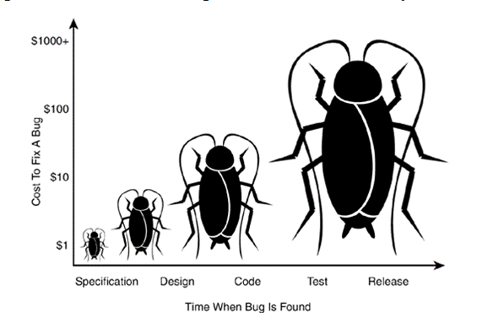
Testing Overview
When to Start Testing ?
The earlier, the better

Slide 34
Testing Overview
When to Start Testing ?
The earlier, the better
Depends on the development model
Waterfall model vs. incremental model
Testing is done in different forms at every phase of SDLC

Slide 35
Testing Overview
When to Stop Testing ?
Testing is a never ending process
Some aspects
--Testing Deadlines.
--Completion of test case execution.
--Completion of functional and code coverage to a certain point.
--Bug rate falls below a certain level and no high priority bugs are identified.
--Management decision.

Slide 36
Summary
The need of SQA & Testing
The basic idea of SQA
Difference between quality assurance and quality control
Testing overview

Slide 37
A question:
Testing is a subset of quality assurance or quality control?

